Slide 1
Customer Support Chat bot with Generative AI
PIP2001 Capstone Project
Final Review
Batch Number: CSD G-19
Under the Supervision of,
Dr. Srabana Pramanik
Assistant Professor (Senior Scale)
School of Computer Science and Engineering
Presidency University
Roll Number | Student Name
20211CSD0002 | Venessa Gwendolyn
20211CSD0158 | Veluru Hitha
20211CSD0082 | Nisarga B.M.
20211CSD0028 | Vibha Swamy
Name of the Program: B.Tech Computer Science Engineering (Data Science)
Name of the HoD: Dr. Saira Banu Atham
Name of the Program Project Coordinator: Dr. Manjula HM
Name of the School Project Coordinators: Dr. Sampath A K / Dr. Abdul Khadar A / Mr. Md Ziaur Rahman

Slide 2
Introduction
The app is designed to provide small entrepreneurs in the industry with an affordable, user-friendly solution for managing their product design, inventory, and orders. The app streamlines the process of showcasing products, placing orders, and handling sales, allowing entrepreneurs to focus on their craft while efficiently running their business. This platform empowers users and sellers alike by offering a seamless interface that combines product design with digital commerce.

Slide 3
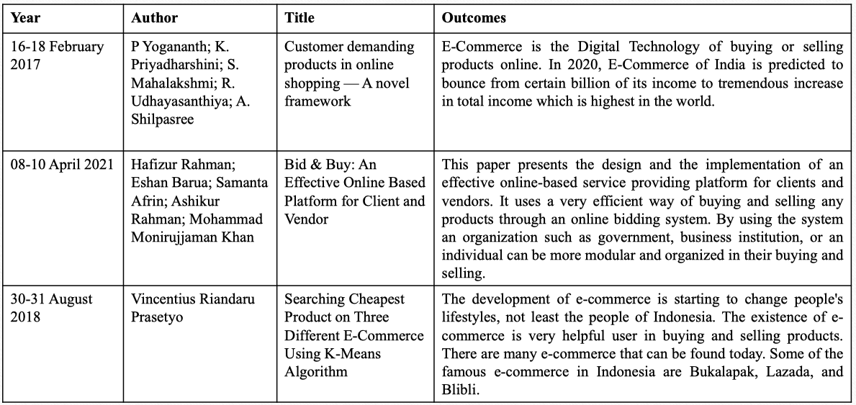
Literature Review

Slide 4
Research Gaps Identified
High costs of professional design and management software
Time-consuming manual processes for managing inventory and orders
Lack of integration between product listing, order management, and payment systems
Inability to provide real-time updates to customers on order status and stock availability

Slide 5
Proposed Methodology
The proposed system will address the limitations of existing methods by offering a unified mobile platform that streamlines the entire process from product listing to order fulfilment. Sellers can log in, add products, manage inventory, and process orders. Users will have access to a wide variety of products, can place orders, and make payments directly through the app. Admins will manage seller accounts, add new sellers, and rate their performance based on customer feedback. This system will significantly improve operational efficiency and enhance the user experience.
.

Slide 6
Objectives
The objective of this project is to create a mobile platform that enables small entrepreneurs to efficiently manage their products and engage with customers.
The app will facilitate product listing, inventory tracking, and order processing, while ensuring a seamless experience for the end-user.
Admins will have the tools to monitor seller performance and maintain platform quality, ensuring that customers receive the best service.
Ultimately, the project aims to enhance business operations for entrepreneurs and provide users with a smooth shopping experience.

Slide 7
Modules
User Module:
Users can register and log in to view products listed by sellers.
Users can place orders and make (Dummy)payments securely.
Users can view their order history and track their orders.
Users can also chat with a bot for product inquiries.
Seller Module:
Sellers can log in with credentials provided by the admin.
Sellers can add products, manage inventory, and view incoming orders.
Sellers can accept orders based on stock availability

Slide 8
Modules(Contd.)
Admin Module:
Admins can add and manage seller accounts.
Admins can rate sellers based on customer feedback and order processing.
Admins can monitor system performance and ensure quality control.

Slide 9
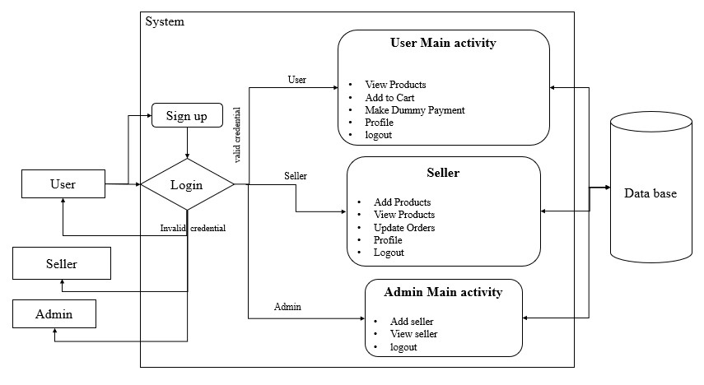
Architecture

Slide 10
Software and Hardware components
Operating System - Windows 10
JDK - Java(kotlin)
SDK - Android
IDE - Android studio
Database - my SQL
Processor - I3/Intel Processor
RAM - 8 GB
Hard Disk - 1TB

Slide 11
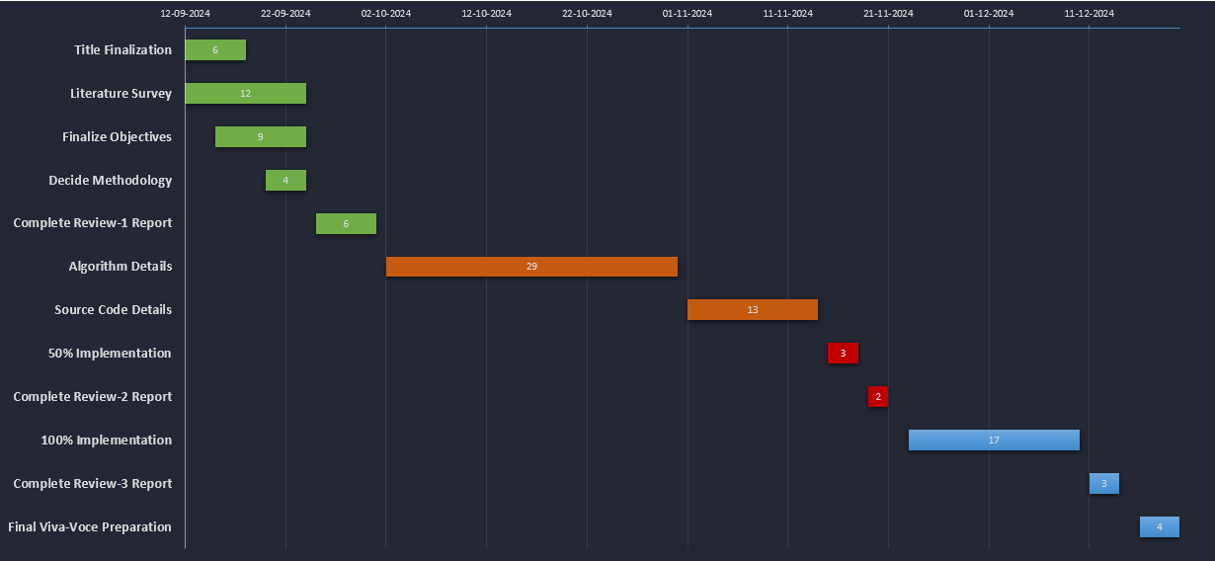
Timeline of Project

Slide 12
Outcomes Obtained
The Project is an innovative solution tailored for small entrepreneurs in the industry. The mobile app provides a user-friendly platform where entrepreneurs can showcase their products, manage inventory, and handle orders.
The system is designed to streamline the process from product display to order fulfillment, allowing sellers to focus on crafting quality goods while efficiently managing their business.
Users of the app can browse products, place orders, make secure payments, and track their purchases.
Users can also chat with a bot for product inquiries. The admin plays a crucial role in adding sellers, managing accounts, and rating their performance.

Slide 13
Conclusion
The mobile application aims to streamline business operations for small enterprises by providing an efficient and user-friendly platform. With features like product browsing, order placement, inventory management, and administrative control, the app serves as a bridge between users and sellers. By empowering sellers to manage their products and orders, and giving users the ability to make seamless transactions, the platform ensures a smooth business experience. The inclusion of admin oversight further enhances reliability and system integrity, making this application a comprehensive solution for small business management.

Slide 14
Github Link
https://github.com/CSD-G19/CustomerServChatbot

Slide 15
References
[1]. P Yogananth; K. Priyadharshini; S. Mahalakshmi; R. Udhayasanthiya; A. Shilpasree; Customer demanding products in online shopping — A novel framework; 16-18 February 2017.
[2]. Hafizur Rahman; Eshan Barua; Samanta Afrin; Ashikur Rahman; Mohammad Monirujjaman Khan; Bid & Buy: An Effective Online Based Platform for Client and Vendor; 08-10 April 2021.
[3]. Vincentius Riandaru Prasetyo; Searching Cheapest Product on Three Different E-Commerce Using K-Means Algorithm; 30-31 August 2018.
[4] Thirumalai, S., & Sinha, K. K. (2005). Customer satisfaction with order fulfillment in retail supply chains: implications of product type in electronic B2C transactions. Journal of Operations Management, 23(3), 291-303
[5] Anupam Mondal; Monalisa Dey; Dipankar Das; Sachit Nagpal; Kevin Garda || Chatbot: An automated conversation system for the educational domain || 15-17 November 2018

Slide 16
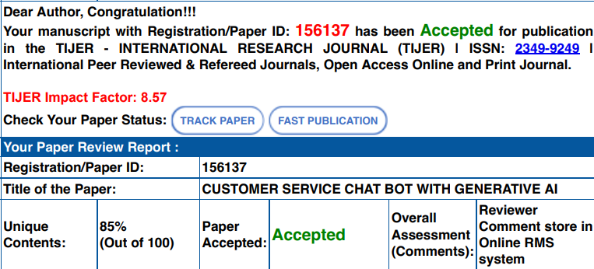
Publication Details

Slide 17
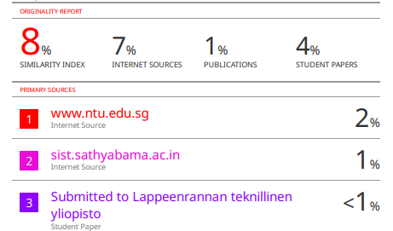
Plagiarism Report

Slide 18
Project work mapping with SDG
SDG 9: Industry, Innovation, and Infrastructure
Innovation: The deployment of generative AI for customer support enhances business innovation, leading to greater operational efficiency.
Infrastructure: It bolsters digital infrastructure by establishing intelligent, scalable systems capable of addressing intricate inquiries in real-time.
SDG 8: Decent Work and Economic Growth
Enhanced Productivity: Automation of routine functions permits employees to concentrate on advanced responsibilities, thereby augmenting productivity and facilitating business expansion.
Job Creation: Although certain positions may be automated, new roles emerge in AI development, training, and support sectors.

Slide 19
Thank You

